Slide 1


Japanese Counter Words 日本語の助数詞
Jiajun Bracewell

Slide 2
objectives
Grammar
Numbers
Counters
Commonly used counters
How to count people
Traditional way of counting small items or years of age
How to count dates
How to count Extent, Frequency

Slide 3
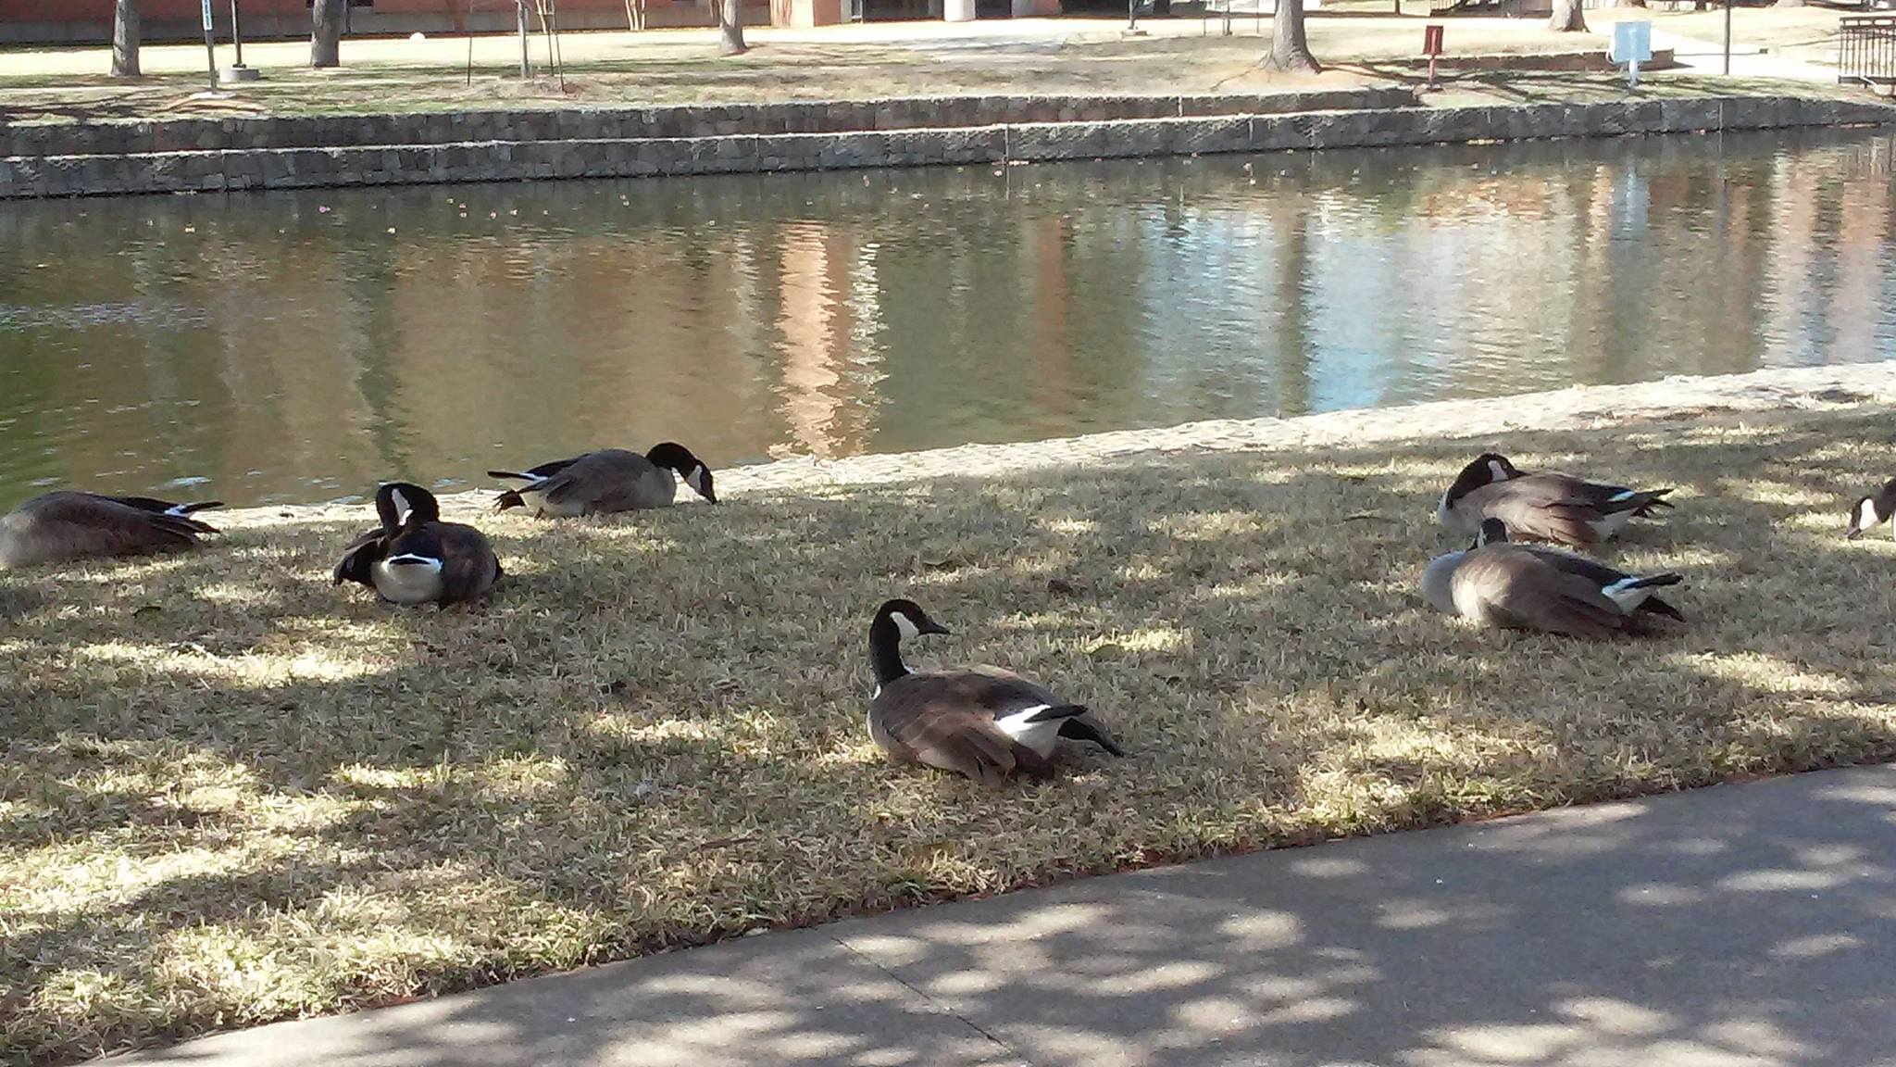
How many ducks are there?

Slide 4

How many ducks are there?
7 ducks
In Japanese
Duck: 鴨(かも、kamo)
7 鴨 ?
鴨7 ?

Slide 5
Grammar
Counters are used with numbers to express quantity and frequency in Japanese.
Generally
Noun + number + counter
鴨 七 匹 (kamo nana hiki)
To emphasize
Number + counter + の + Noun
七 匹 の 鴨 (nana hiki no kamo)

Slide 6
Numbers
Numeral | kanji | pronunciation (hiragana) | pronunciation (romaji)
1 | 一 | いち | ichi
2 | 二 | に | ni
3 | 三 | さん | san
4 | 四 | し・よん・よ | shi/yon/yo
5 | 五 | ご | go
6 | 六 | ろく | roku
7 | 七 | しち・なな | shichi/nana
8 | 八 | はち | hachi
9 | 九 | きゅう・く | kyuu/ku
10 | 十 | じゅう | jyuu
11 | 十一 | じゅういち | jyuuichi
12 | 十二 | じゅうに | jyuuni
13 | ? | ? | ?

Slide 7
Counters
Generally
Noun + number + counter
鴨 七 匹 (kamo nana hiki)
To emphasize
Number + counter + の + Noun
七 匹 の 鴨 (nana hiki no kamo)
の is the possessive particle, similar to “’s” in “Mary’s book”, or “of” in the “book of Mary”
Similar in function to the word “pieces” ,“cups”, “bottles”
Two pieces of paper
Three cups of water
Four bottles of wine

Slide 8


Counters
How many?
Probably 500.
Commonly used ones?
A few

Slide 9
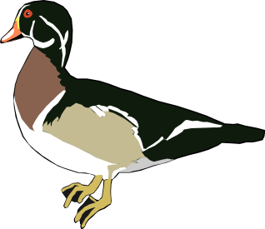


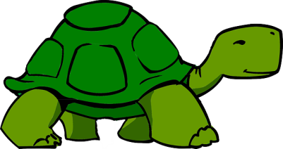
Commonly used counters
匹
ひき hiki, ぴき piki, びき biki *
Small animals, insects, fish, reptiles, amphibians, oni (demons/ogres)
*Euphonic changes occur when particular numbers precede counters that begin with certain phonemes.
鴨(かも, kamo) 一匹の鴨 ippiki no kamo
テントウムシ(tentoumushi) 一匹のテントウムシ
ippiki no tentoumushi
魚（さかな, sakana） 一匹の魚 ippiki no sakana
亀（かめ, kame） 一匹の亀 ippiki no kame

Slide 10

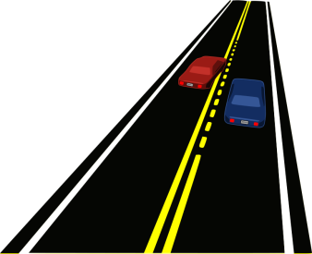


Commonly used counters
本
ほん hon, ぽん pon, ぼん bon
long, thin, cylindrical objects: pens, pencils, bananas, fingers, legs, trees, streets, roads, tapes, pants, bottles, etc.; also, metaphorically, telephone calls, train or bus routes, movies, points or bounds in sports events.
鉛筆（えんぴつ、enpitsu） 一本の鉛筆
Ippon no enpitsu
ネクタイ（nekutai） 一本のネクタイ ippon no nekutai
道（みち、michi） 一本の道
Ippon no michi
木(き、ki)
一本の木 ippon no ki

Slide 11
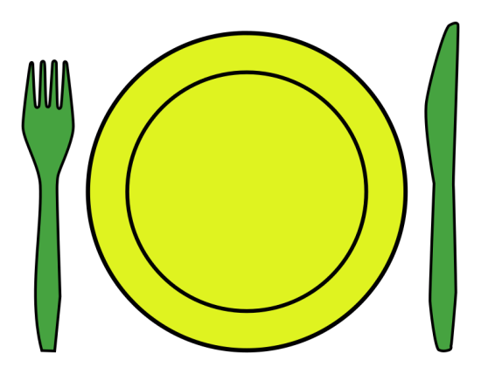

Commonly used counters
枚
まい mai
Thin, flat objects: sheets of paper, photographs, plates, articles of clothing
写真（しゃしん、syashin）
一枚の写真
Ichimai no syasin
皿（さら、sara） 一枚の皿
Ichimai no sara
紙（かみ、kami） 一枚の紙
Ichimai no kami

Slide 12
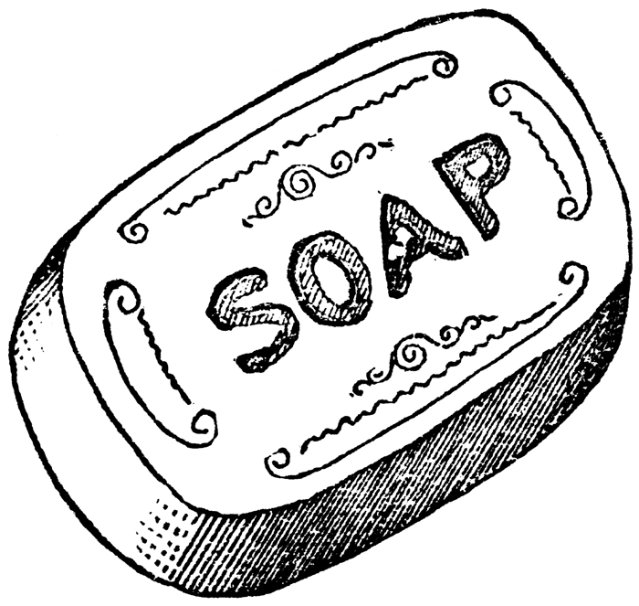


Commonly used counters
個
こ ko
General measurement word, used when there is no specific counter. Implies that the item is small and/or round.
りんご（ringo）
一個のリンゴ
Ikko no ringo
石鹸（せっけん、sekken）
一個の石鹸
Ikko no sekken
積み木(つみき、tsumiki)
一個の積み木
Ikko no tsumiki

Slide 13
Commonly used counters
匹 (ひき hiki, ぴき piki, びき biki): Small animals, insects, fish, reptiles, amphibians, oni (demons/ogres)
本(ほん hon, ぽん pon, ぼん bon): Long, thin objects: rivers, roads, train tracks, ties, pencils, bottles, guitars; also, metaphorically, telephone calls, train or bus routes, movies, points or bounds in sports events.
枚(まい mai): Thin, flat objects: sheets of paper, photographs, plates, articles of clothing
個(こ ko): General measurement word, used when there is no specific counter. Implies that the item is small and/or round.
Each counter summarizes the most common features of one group of items.
Group ID

Slide 14
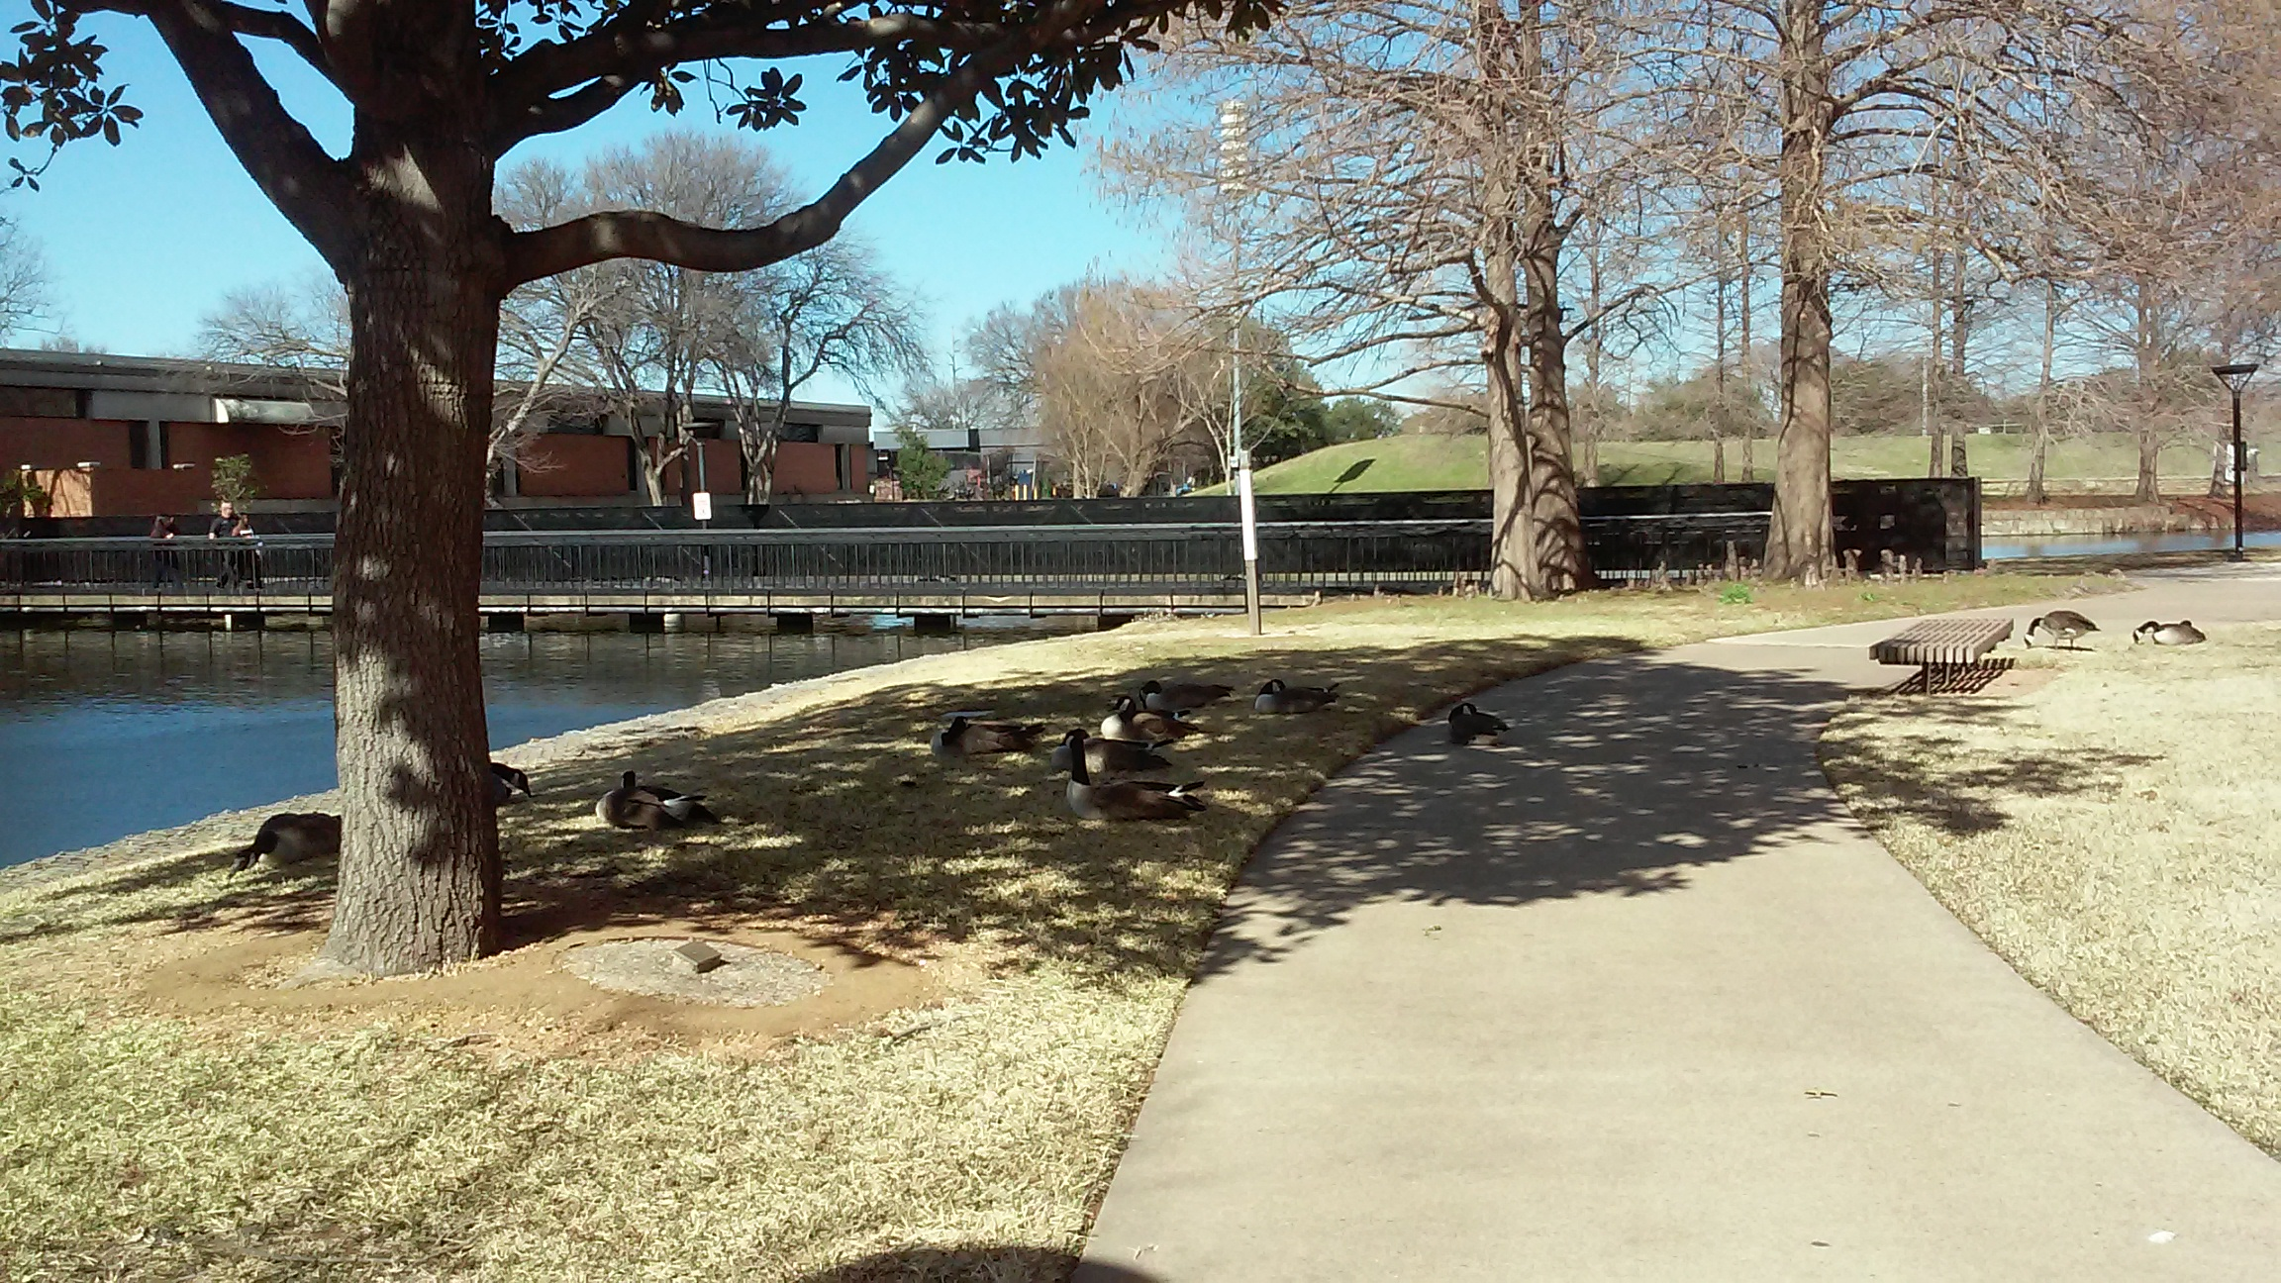

Slide 15

How many ducks?
Number + counter + の + Noun
十二匹の鴨（12 ducks）
Jyuunihiki no kamo

Slide 16
How many big trees?
Number + counter + の + Noun
三本の大きな木（3 big trees）
Sanbon no ookina ki

Slide 17

How many branches do you see?
Number + counter + の + Noun
5 branches (You did not tell me what kind of counter for branches
Branch： long and thin ---- 本(hon)
五本の枝 (gohon no eda)

Slide 18
There is a road!
Number + counter + の + Noun
a road
Road: long and thin ---- 本 (hon)
一本の道 (ippon no michi)

Slide 19
There is a bridge!
Number + counter + の + Noun
a bridge (You did not tell me what kind of counter for branches
bridge： long and thin ---- 本 (hon)
一本の橋 (ippon no hashi)

Slide 20
There is a river!
Number + counter + の + Noun
a river
River： long and thin ---- 本(hon)
一本の川 (ippon no kawa)

Slide 21
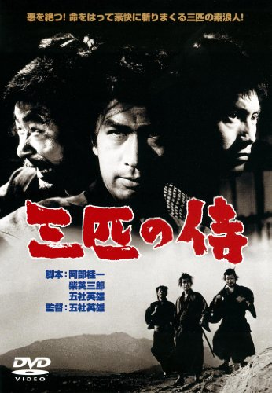
How to count people
匹 ？
Intentionally misused for humorous, sarcastic, or insulting effects.
一匹の男 (ippiki no otoko, an independent man, humorously suggests that the person intends to act against massive obstacles with some animal spirits.)
三匹の侍 (sanbiki no samurai, Three Outlaw Samurai）
人（にん、nin）
Generally used
名（めい、mei）
To be polite

Slide 22
How to count people --人（にん、nin）
Numeral | kanji | pronunciation (hiragana) | pronunciation (romaji)
1 | 一人 | ひとり NOT いちにん | Hitori NOT itchinin
2 | 二人 | ふたり NOT ににん | Futari NOT ninin
3 | 三人 | さんにん | sannin
4 | 四人 | よにん | yonin
5 | 五人 | ごにん | gonin
6 | 六人 | ろくにん | rokunin
7 | 七人 | ななにん | nananin
8 | 八人 | はちにん | hachinin
9 | 九人 | きゅうにん | kyuunin
10 | 十人 | じゅうにん | jyuunin

Slide 23
How to count people
10 teachers
人（にん、nin）
十人の先生 （generally）
Jyuunin no sensei
名（めい、mei）
十名の先生 (To be polite, 名 means "name")
Jyuumei no sensei

Slide 24
Traditional way of counting small items or years of age
Numeral | Japanese | Pronunciation (hiragana) | Pronunciation (romaji)
1 | 一つ | ひとつ | hitotsu
2 | 二つ | ふたつ | futatsu
3 | 三つ | みっつ | mittsu
4 | 四つ | よっつ | yottsu
5 | 五つ | いつつ | itsutsu
6 | 六つ | むっつ | muttsu
7 | 七つ | ななつ | nanatsu
8 | 八つ | やっつ | yattsu
9 | 九つ | ここのつ | kokonotsu
10 | 十 | とお | tō

Slide 25
How to count dates
Numeral | Japanese | Pronunciation (hiragana) | Pronunciation (romaji)
1 | 一日 | ついたち | tuitati
2 | 二日 | ふつか | futuka
3 | 三日 | みっか | mikka
4 | 四日 | よっか | yokka
5 | 五日 | いつか | ituka
6 | 六日 | むいか | muika
7 | 七日 | なのか | nanoka
8 | 八日 | ようか | youka
9 | 九日 | ここのか | kokonoka
10 | 十日 | とおか | tooka

Slide 26
How to count Extent, Frequency
ばい bai | 倍 | Multiples, -fold as in "twofold"
ばん ban | 番 | Position, turn, sports matches
ど do, also たび tabi | 度 | Occurrences, number of times, degrees of temperature or angle
かい kai | 回 | Occurrences, number of times

Slide 27

How many ducks are there? -- easy way to answer a question
Q：何匹の鴨がいますか？How many ducks are there?
Nanbiki no kamo ga imasu ka?
A:七匹の鴨がいます。7 ducks are there.
Nanahiki no kamo ga imasu.
Copy the same structure of the question.
Replace the question word (何) with the needed information (the number).
Delete the question particle か.

Slide 28

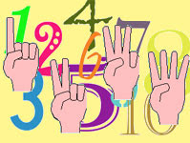
Oops, I forgot which counter to use
Number + 個 + Noun
個(こ ko), General measurement word, used when there is no specific counter. Implies that the item is small and/or round. 個 is also used for military units.
Number + Noun
七鴨（なな かも、nana kamo）
Use fingers to show the number

Slide 29
Further Reading
Japanese counter word
https://en.wikipedia.org/wiki/Japanese_counter_word
助数詞
https://ja.wikipedia.org/wiki/%E5%8A%A9%E6%95%B0%E8%A9%9E#.E6.97.A5.E6.9C.AC.E8.AA.9E.E3.81.AE.E5.8A.A9.E6.95.B0.E8.A9.9E
GENKI: An Integrated Course in Elementary Japanese I [Second Edition]
数詞 (Counters)
http://www.laits.utexas.edu/japanese/joshu/counters.php
Japanese/Grammar/Counters
https://en.wikibooks.org/wiki/Japanese/Grammar/Counters

Slide 30
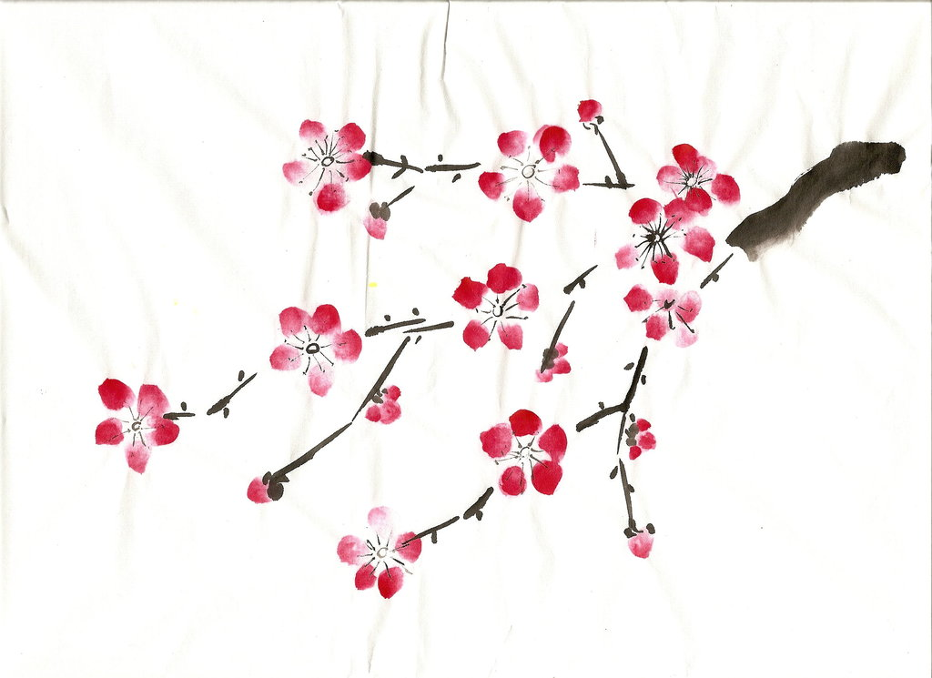
Thank you!
ありがとうございます。
Arigatou gozaimasu.

